Slide 1
Session - 3

Slide 2
Objectives
Introduction to BMS
Physical and Symbolic Map
Map and Mapset
Map Definition Macros
Screen Design Considerations

Slide 3
Introduction To BMS
(Basic Mapping Support)
Primary functions of BMS
  Removal of device dependent codes from Application Program
  Removal of constant information from Application program (Headers, Titles...)
  Construct NMDS - Native Mode Data Stream
  Text handling
  Terminal Paging & Message routing
  Contents of the screen defined thru’ BMS is called Map.
  Map is a program written in assembly language.
  BMS macros are available for Map coding.
Notes:
In order to display formatted screen, a terminal ( eg. 3278) must receive a series of data stream called Native Mode Data Stream(NMDS) which is a mixture of Buffer Control Characters(BCCs) and text data, based on the hardware protocol. Since NMDS is designed for a particular terminal, it is both device dependent and format dependent. So if NMDS is used, re-coding is required whenever there is change in the terminal device or screen format. To remove this device and format dependency from application program, CICS provides a facility called BMS
Remove device dependent codes - by placing them (3270 BCCs) in maps
eg. screen size
Remove constant information - by placing the default constants in maps
Terminal Paging : Allows combination of several small mapped data areas into one or more pages of output.
Message Routing : Allows sending of messages to one or more terminals.

Slide 4
Map & Mapset
Representation of one screen format is called Map (screen panel).
One or more maps, linkedited together, makes up a Mapset (load module).
Notes:
Mapset must have a entry in PPT
Mapset name has two parts.
Generic name 1- 7 chars. Used in App. Pgm.
Suffix 1 char. To identify the device type
Multimap Panel
Dynamically constructing a screen panel with multiple maps at the execution time
PPT :- Processing Program Table. It registers all CICS application programs.
Application program uses only the generic name. The suffix is required at the map definition time in order to distinguish the device types if the same mapset is used for different types of terminals. While the application program uses only the generic name of the mapset name, CICS automatically inserts the suffix depending on the terminal in use, thereby ensuring the device independence to the application program.

Slide 5
Types of Maps
There are 2 types of MAPS
Physical Map
Symbolic Map
Notes:
Physical Map:
Physical Map is a map used by CICS ( CSECT)
Ensure device independence in the application program
Symbolic Map:
Ensure device and format independence in the app prog
Symbolic Map is a map used by Application Program (DSECT)

Slide 6
Example of Symbolic Map
  01 EMPRECI.
  02 FILLER PIC X(12).
  02 EMPNAL PIC S9(4) COMP.
  02 EMPNAF PIC X.
  02 FILLER REDEFINES EMPNAF.
  03 EMPNAA PIC X.
  02 EMPNAI PIC X(21).
  01 EMPRECO REDEFINES EMPRECI.
  02 FILLER PIC X(12).
  02 FILLER PIC X(03).
  02 EMPNAO PIC X(21).
Notes:
Symbolic Map contains 4 fields for each data field.
L field : - The halfword binary (PIC S9(4) COMP field. For the input, the actual number of chars. typed in the field will be placed by BMS when the map is received. For the output, this is used for dynamic cursor positioning.
F field : - Flag byte. It will set to on/off based on whether the field is modified or not.
A field : - The attribute byte which defines the characteristics (Highlight, Protect, etc) of both input and output fields.
I/O field : - Field which contains the actual data. Usually I and O fields are same. Different when edited PIC is used.
Because of the way the input and output parts of the map structure overlay each other, the -I and the -O subfields for a given map field always redefine each other.
The attribute and flag subfields occupy the same space

Slide 7
Physical & symbolic Map – logic flow
BMS
source
Assembler
Physical MAP
Symbolic MAP
Linkage editor
Load module (MVS)
Notes:
Physical Map :-
BMS macro coding ==> Assembly==>Linkedit==>Load module ==> LOADLIB===> To be used by CICS
Symbolic Map :-
BMS macro coding==> Assembly==>Symbolic map definition==> COPYLIB==> Copied(COPY) into CICS application program.

Slide 8
Map Definition Macros
  General Format
  1 10 16 72
  setname operation operands contd.
  Example
  EMPMAP DFHMSD TYPE=MAP, X
  MODE=INOUT, X
  LANG=COBOL, X
  STORAGE=AUTO, X
  TIOAPFX=YES
  *
  * ANY COMMENTS
Notes:
The macro coding for designing the screen should be done in the dataset with the following convention:
Column 1:Setname : Name of the mapset. Used in CICS command to read or write one of the maps in the mapset. Its the load module name.
Column 10: Operation : Macro identifier. Mapset/Map/Field definition.
Column 16: Operands : Optional key words (parameters) separated by comma
Column 72: Contd. Current line can be continued by leaving this column non-blank (usually X) and the next line has to be started in 16th column.
‘*’ in col 1 makes the line comment
Always surround initial values by single quote marks
Escape chars : ‘ and &

Slide 9
Order of Macros
DFHMSD TYPE=DSECT Mapset
DFHMDI Map
DFHMDF A field
DFHMDF A field
:
DFHMDI Map
DFHMDF A field
DFHMDF A field
:
DFHMSD TYPE=FINAL Mapset
END
Notes:
DFHMSD - To define a Mapset
DFHMDI - To define a Map
DFHMDF - To define a field

Slide 10
DFHMSD Macro
Define a mapset and its characteristics or to end a mapset definition
Only one mapset is allowed in one assembly run.
Example
EMPMSET DFHMSD TYPE=&SYSPARM , X
MODE=INOUT, X
LANG=COBOL, X
STORAGE=AUTO, X
TIOAPFX=YES, X
CTRL=(FREEKB,FRSET,PRINT)
Notes:
All the maps in a map set get assembled together, and they're loaded together at execution time.
EMPMSET :- Name of the mapset used in a CICS command to send or receive a map in that mapset.
It's the load module name.
DFHMSD
This is the macro identifier. It shows that you're starting a map set.
TYPE=type
TYPE governs whether the assembly produces the physical map(MAP) or the symbolic description (DSECT).
&SYSPARM - assembly proc.
DSECT - symbolic map
MAP - physical map
FINAL - end of mapset coding
MODE=mode
This shows whether the maps are used only for input (MODE=IN), only for output (MODE=OUT), or for both (MODE=INOUT).
LANG=COBOL
This decides the language of the DSECT structure, for copying into the application program.
STORAGE=AUTO
For a COBOL program, this operand causes the DSECT structures for different maps in a map set not to overlay each other.
TIOAPFX=YES
The first 12 characters in the DSECT (FILLER) are reserved for CICS control information
CNTL=
FREEKB Unlock the keyboard
FRSET Reset MDT to zero
PRINT Send the map set to a printer
.

Slide 11
DFHMDI Macro
Define a map and its characteristics
Example
EMPMAP DFHMDI SIZE=(ll,cc), X
LINE=nn, X
COLUMN=mm, X
JUSTIFY=LEFT/RIGHT
Notes:
EMPMAP is a map name used in a CICS command to send or receive a map.
DFHMDI - This is the macro identifier. It shows that you're starting a new map.
SIZE - Define the size of the map by line(ll) and column(cc).
Useful when the screen contains multiple maps.
LINE & COLUMN indicates the starting position of the map.
JUSTIFY :- Used to specify the entire map (map fields) to be left or right justified.

Slide 12
Screen Layout
&Customer No. :&nnnnnnnn
Where
  & Attribute character
  n Unprotected numeric
  - Cursor
Notes:
This shows the screen layout expected in the CICS region.

Slide 13
DFHMDF macro for the above layout
Define a field and its characteristics
Example
  DFHMDF POS(ll,cc), X
  INITIAL=‘Customer No. :’, X
  ATTRB=ASKIP, X
  LENGTH=14
  CUSTNO DFHMDF POS=(ll,cc), X
  ATTRB=(UNPROT,NUM,FSET,IC), X
  JUSTIFY=RIGHT, X
  PICIN=‘9(8)’, X
  PICOUT=‘9(8)’, X
  LENGTH=8
Notes:
CUSTNO:- This is the name of the field used in the program. Its required only if used in the program. Its not necessary for defining constant information(field headings).
DFHMDF :- This is the macro identifier. It shows that you are defining a field.
POS=(line,column) :- This is the position on the screen where the field should appear. It's the
position relative to the beginning of the map. Field starts with its attribute byte, so if POS=(1,1) is
coded, then the attribute byte for that field is on line 1 in column 1, and the actual data starts in column 2.
LENGTH=number :- This is the length of the field, not counting the attribute byte
INITIAL='text' :- This is the character data for an output field. Used to define labels and titles for the screen and keep them independent of the program.

Slide 14
Attribute character
Invisible one byte character
Defines the characteristics of a field
  Thru’ ATTRB param. of DFHMDF.
Notes:
There are different kinds of attributes
- Attributes to control the display intensity of the field
- Keyboard Attributes
- Attribute Related to the Field Modification
- Cursor Control Attribute
Attributes to control the display intensity of the field :-
NORM Normal display intensity.
BRT Bright (highlighted) intensity.
DRK Dark (not displayed).
Keyboard Attributes :-
ASKIP The field cannot be keyed into, and the cursor will skip over it if the user fills the preceding field.
PROT The field cannot be keyed into, but the cursor will not skip over it if the user fills the preceding field.
UNPROT The field can be keyed into.
NUM The field can be keyed into, but only numbers, decimal points and minus signs are allowed.
Attribute Related to the Field Modification :-
FSET Turns on the modified data tag. This causes the field to be sent on the subsequent read whether or not the user keys into it. If it is not specified, the field is sent only if the user changes it.
Cursor Control Attribute :-
IC Places the cursor under the first position of the field. If IC is specified for more than one field, the last one specified will be the one used.

Slide 15
Modified Data Tag
Indicates the field has been modified or not
Effective use of MDT reduces the amount of data traffic.
MDT setting/resetting
  - when the user modifies a field on the screen
  - CTRL=FRSET, defined in map/mapset
  - FSET in ATTRB parameter of DFHMDF
Notes:
MDT on/off indicates whether the field is modified or not. Only if it is on, the value of the field is sent to the host computer.
When the program expects all the fields and if few fields are not received ‘cause of MDT not set to ‘on’, it causes problem. To avoid that, all the input fields can be set to ‘on’ by giving FSET in ATTRB parameter.
To reset all the map fields, CNTL=FRSET can be used in map or mapset definition which will prevent the MDT status of each field of the map from being carried over from the previous display of the same map.

Slide 16
Dynamic Attribute Assignment
0 1 2 3 4 5 6 7
0 and 1 – Dependent bits( 0 on 2 & 1 on 7)
2 and 3 – Attribute
  2 – 0 protected 1 unprotected
  3 – 0 alphanumeric 1 numeric
4 and 5 – Intensity
  0 0 (norm/non detectable)
  0 1(norm/detectable)
  1 0(BRT)
  1 1(DRK)

Slide 17
Skipper Technique
Skipper technique is used to skip the cursor to the next unprotected field after one unprotected field.
Unlabelled 1-byte field with the autoskip attribute
DFHMDF POS(ll,cc),ATTRB=ASKIP,LENGTH=1
Notes:
Skipper technique is used to skip the cursor to the next unprotected field after one unprotected field.
Screen Layout :
&xxxxx&$ &xx
where
$ Skipper field
& Attribute byte
X Unprotected field
Without the skipper field, the cursor would stop after the first unprotected field, then the gap should be passed on to go to the next unprotected field.

Slide 18
Stopper Technique
To stop the cursor in order to prevent erroneous field overflow by terminal user the stopper technique can be used.
Unlabelled 1-byte field with the protect attribute
DFHMDF POS(ll,cc),ATTRB=PROT,LENGTH=1
Notes:
To stop the cursor in order to prevent erroneous field overflow by terminal user the stopper technique can be used.
Screen Layout :
&xxxxx&$#&$
where
# Stopper field
Stopper ensures a proper data entry to the field by not-allowing the user to type more the defined length.

Slide 19
Cursor Positioning Techniques
Static positioning (map definition)
Dynamic/Symbolic Positioning (app.pgm)
Dynamic/Relative Positioning (app. pgm)
Checking Cursor Position by EIBCPOSN.
Notes:
Static positioning (map definition)
IC in ATTRB parameter of DFHMDF
If ‘IC’ is used with more than one field, the cursor will appear in the last field.
Dynamic/Symbolic Positioning (application program)
Move -1 to the field-length field and
SEND map with CURSOR option
Dynamic/Relative Positioning (application program)
SEND with CURSOR(data-value) option.

Slide 20
  Static positioning (map definition)
  IC in ATTRB parameter of DFHMDF
  If ‘IC’ is used with more than one field, the cursor will appear in the last field.
  Dynamic/Symbolic Positioning (application program)
  Move -1 to the field-length field and
  SEND map with CURSOR option
  Dynamic/Relative Positioning (application program)
  SEND with CURSOR(data-value) option.

Slide 21
Numeric Sign / Decimal Point Handling
Numeric Sign : For input operations, Separate fields or CR/DR field approach can be used and for output operations, PICOUT parameter can be given in macro
Decimal Point : For input operations, Virtual decimal point or Separate fields approach can be used and for output operations, PICOUT parameter has to be given in the field definition macro.
Notes:
Numeric Sign Handling for Output operations : PICOUT parameter can be given along with the field definition while coding macro. In the program, the signed numeric value can be moved into the field in the symbolic map.
In Macro,
BALAMT DFHMDF POS(XX,XX),ATTRB=(ASKIP),
LENGTH=10
PICOUT=‘ZZ,Z9.99-’
In Application Program,
MOVE CUST-AMTBAL TO BALAMTO.
Where CUST-AMTBAL is defined as S9(5)v99 COMP-3
Numeric Sign Handling for Input operations :
1. Having two fields and enter the coressponding amount.
CREDIT(+) or DEBIT(-)
Transaction Amount : xxxxxxxx xxxxxxx
2. Entering C/D in a filed followed by numeric field and allow the program to manipulate it
AMOUNT CR(+) / DR(-)
Transaction Amount xxxxxxxx xx
Decimal Point Handling :
For output operations, same as ‘Numeric Handling’ PICOUT parameter can be used along with the field definition to give the required picture clause.
For input operations, either one of the following two methods can be used.
1. Allowing the user to enter numeric field as such with a virtual decimal point.
AMOUNT : XXXXXXX
The above value has to read as 9(5)v99 or as required
2. Creating separate fields one for integer and one for decimal.
DOLLAR CENTS
AMOUNT : XXXXX XX

Slide 22
Send Map
EXEC CICS SEND
MAP(‘map name’)
[MAPSET(‘mapset name’)]
[FROM(data-area)]
[LENGTH(data_value)]
[DATAONLY]
[MAPONLY]
[ERASE/ERASEAUP]
[FREEKB]
[FRSET]
END-EXEC
Conditions : INVREQ,LENGERR
Notes:
Mapname : Name of the map to be send. It's required.
Mapsetname : Name of the map set that contains the mapname.
MAPONLY : No data from your program is to be merged into the map. Only the information in the map is transmitted.
DATAONLY : Only the data from your program is sent to the screen. The constants in the map aren't sent
FROM : It is used to specify the area in the working storage section from which the data is to be sent to the terminal.
ERASE : Causes the entire screen to be erased before what has been sent is shown .
FRSET : (flag reset) turns off the modified data tag in the attribute bytes for all the fields on the screen before what has been sent is placed there.
CURSOR: Value given after the Cursor will be the relative position on the screen where the cursor is to be put. Cursor without a value use the length subfields in the output map to show which field is to get the cursor.
ALARM : It causes the audible alarm to be sounded. The alarm will sound if the ALARM is specified either in the map definition or the SEND command.
FREEKB : The keyboard is unlocked if you specify FREEKB in either the map or the SEND command.
RESP : CICS places a response code at a completion of the command. The application program can check this code and then proceed to the next processing.
HANDLE : It is used to transfer control to the procedure label specified if the exceptional condition specified occurs.
NOHANDLE : It will cause no action to be taken for any exceptional condition occurring during execution of the CICS command.
Handle Conditions:-
INVREQ : Requested operation is not allowed
LENGERR CICS discards the data because the data length is out of the range of allowable values.
NOTALLOC Condition is set when the command is issued from a transaction which is started from a non-terminal task.

Slide 23


Slide 24
RECEIVE Map
To receive input from a terminal
Syntax :
EXEC CICS RECEIVE MAP (mapname)
[INTO(dataname) ]
[LENGTH(msg-len)]
[ MAPSET(mapsetname) ]
[ HANDLE | NOHANDLE
[ RESP() ] ]
END-EXEC
Conditions: INVREQ, MAPFAIL
Notes:
The MAP and MAPSET parameters have exactly the same meaning as for the SEND MAP command. MAP is required and so is MAPSET, unless it is the same as the map name.
INTO : It is used to specify the area in the working storage section to which the data from the terminal is to be placed.
LENGTH : Halfword binary field S9(4) COMP, indicates the length of the message to be received.
SET : CICS sets the address pointer to the address of the symbolic map so that the application program can directly refer to the record without moving the record content into the working storage area defined in the program.
Handle Conditions:-
EODS - Set when no data is received
INVMPSZ - Set when the doesn’t fit into the terminal
INVREQ - Set when the RECEIVE command is issued from non-terminal task
MAPFAIL - Set when the data being mapped has a length of zero. It occurs when the following keys are pressed in response to the RECEIVE MAP command.
CLEAR or Attention Keys & ENTER or PF keys without entering data

Slide 25
FORMAT OF SYMBOLIC MAP
A 12-byte TIOA (Terminal Input/Output Area) prefix.
The mapnames are suffixed with ‘I’ and ‘O’
When performing INPUT functions fields suffixed with ‘L’, ’F’ and ‘I’ are meaningful
When performing OUTPUT functions fields suffixed with ‘A’, and ‘O’ are meaningful

Slide 26
Recap
What is a BMS?
What are the two kinds of maps? Why do we need them?
What are the macros used to define?
What is MDT, FSET and FRSET?
What are the symbolic map fields generated?
What are the cursor positioning techniques??

Slide 27
Lab Session

Slide 28
Macro Coding For map design
000001 MAPLE41 DFHMSD TYPE=&SYSPARM,LANG=COBOL,STORAGE=AUTO, X
000002 TIOAPFX=YES,MODE=INOUT
000003 EMP DFHMDI SIZE=(24,80),LINE=1,COLUMN=1,CTRL=(FREEKB,FRSET)
000004 DFHMDF POS=(5,20),ATTRB=(NORM,ASKIP),LENGTH=16, X
000005 INITIAL='EMPLOYEE DETAILS'
000006 DFHMDF POS=(9,15),ATTRB=(NORM,ASKIP),LENGTH=20, X
000007 INITIAL='EMPLOYEE NUMBER : '
000008 ENO DFHMDF POS=(9,36),ATTRB=(NORM,UNPROT,IC,FSET),LENGTH=4, X
000009 INITIAL='----'
000010 DFHMDF POS=(11,15),ATTRB=(NORM,ASKIP),LENGTH=20, X
000011 INITIAL='EMPLOYEE NAME : '
000012 ENAME DFHMDF POS=(11,36),ATTRB=(NORM,UNPROT,FSET),LENGTH=15, X
000013 INITIAL='---------------'
000014 DFHMSD TYPE=FINAL
000015 END
Notes:
The map design is done with macro coding using the macros that we have discussed for the mapset, map and the fields with their corresponding parameters. Here lets take a simple example where the employee details like employee number and the employee’s name may be designed in a screen.

Slide 29
JCL to assemble macro coding
//MAPLE41C JOB NOTIFY=MAPLE41
// JCLLIB ORDER=(MAPLE41.CICS.TEMP)
//STEP01 EXEC PROC=BMPJCL1,MEM=EMAP
//C.SYSIN DD DISP=SHR,DSN=MAPLE41.CICS.TEMP(&MEM)
//L.SYSLMOD DD DISP=SHR,DSN=CICSTS22.MAPLE.PRGLOAD3(MAPLE41)
//CSYM.SYSIN DD DISP=SHR,DSN=MAPLE41.CICS.TEMP(&MEM)
//CSYM.SYSLIN DD DISP=SHR,DSN=MAPLE41.SYSMB.PDS(&MEM)
Notes:
This shows the JCL for assembling the mapset which we have designed for employee details with the name EMAP. The macro coding is given in C.SYSIN and CSYM.SYSIN. The physical mapset load module is generated in L.SYSLMOD and the symbolic map for the EMAP is generated in CSYM.SYSLIN when the JCL is submitted.

Slide 30
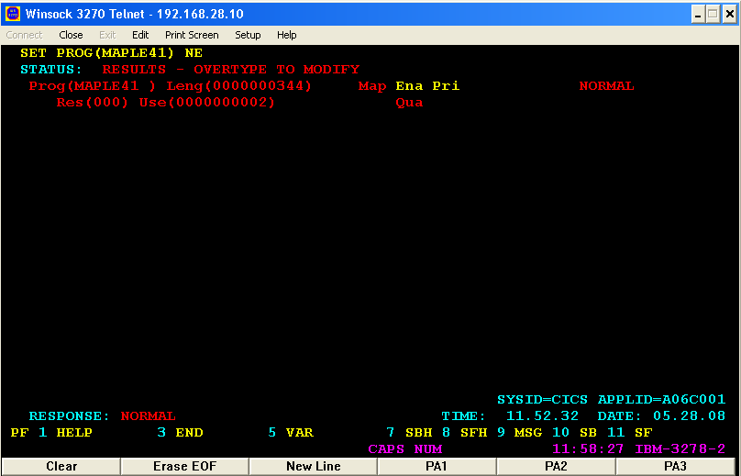
Notes:
In CICS region, the mapset with the mapset-id should be loaded using the ‘CEMT SET PROG(MAPLE41) NE’ command and the RESPONSE should be NORMAL.

Slide 31
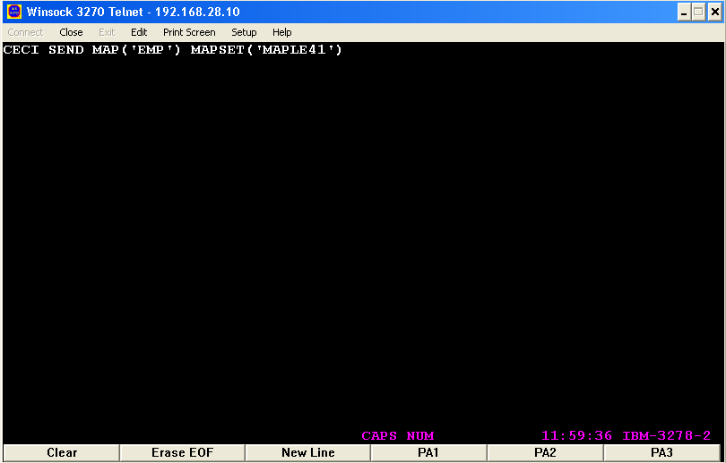
Notes:
Now, the physical map may be viewed using the command ‘CECI SEND MAP(‘EMP’) MAPSET(‘MAPLE41’)’.
NOTE : The name of the map that is in the mapset is EMP.

Slide 32
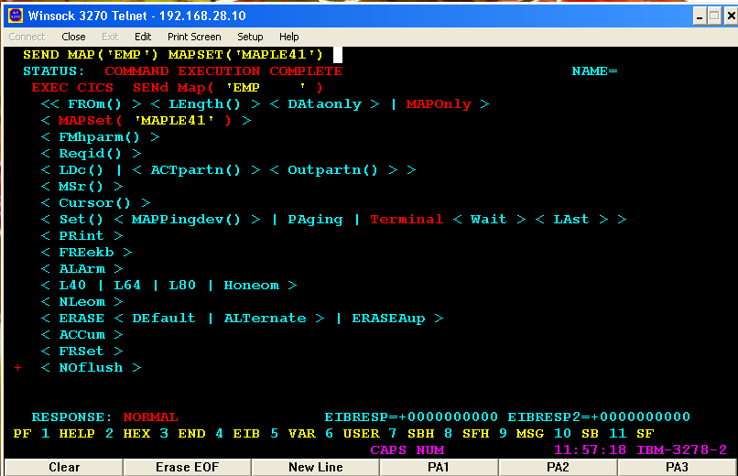
Notes:
The screen appears with NORMAL as response status. The possible errors may be ABM0 (MAPFAIL) where the name of the map may be wrong.

Slide 33
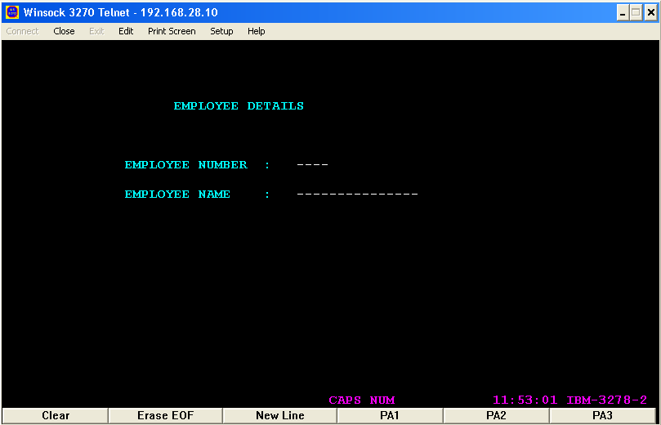
Notes:
This is the map design that appears where the user may enter the data for processing. This map may be used in the next session where the map may be send to and received from the user to conveniently work with files.

Slide 34
Skipper Technique
000001 MAPLE41 DFHMSD TYPE=&SYSPARM,LANG=COBOL,STORAGE=AUTO, X
000002 TIOAPFX=YES,MODE=INOUT
000003 EMAP1 DFHMDI SIZE=(24,80),LINE=1,COLUMN=1
000004 DFHMDF POS=(5,10),ATTRB=(NORM,PROT),LENGTH=16, X
000005 INITIAL='EMPLOYEE DETAILS'
000006 DFHMDF POS=(7,7),ATTRB=(NORM,PROT),LENGTH=11, X
000007 INITIAL='EMP NAME : '
000008 ENAME DFHMDF POS=(7,20),ATTRB=(NORM,UNPROT,IC),LENGTH=10, X
000009 INITIAL='----------'
000010 DFHMDF POS=(7,31),ATTRB=(NORM,ASKIP),LENGTH=1
000011 DFHMDF POS=(9,7),ATTRB=(NORM,PROT),LENGTH=11, X
000012 INITIAL='EMP ID : '
000013 ENUM DFHMDF POS=(9,20),ATTRB=(NORM,UNPROT),LENGTH=5, X
000014 INITIAL='-----'
000015 DFHMSD TYPE=FINAL
000016 END
Notes:
The statement 000010 shows the coding to implement the skipper technique. When the user enters the data in the ENAME field when the length 10 is reached the cursor automatically skips to the next field that is ENUM.

Slide 35
Try Yourself!
Design a map to get the student details like student ID, student name, marks for 3 major subjects.

